Slide 1
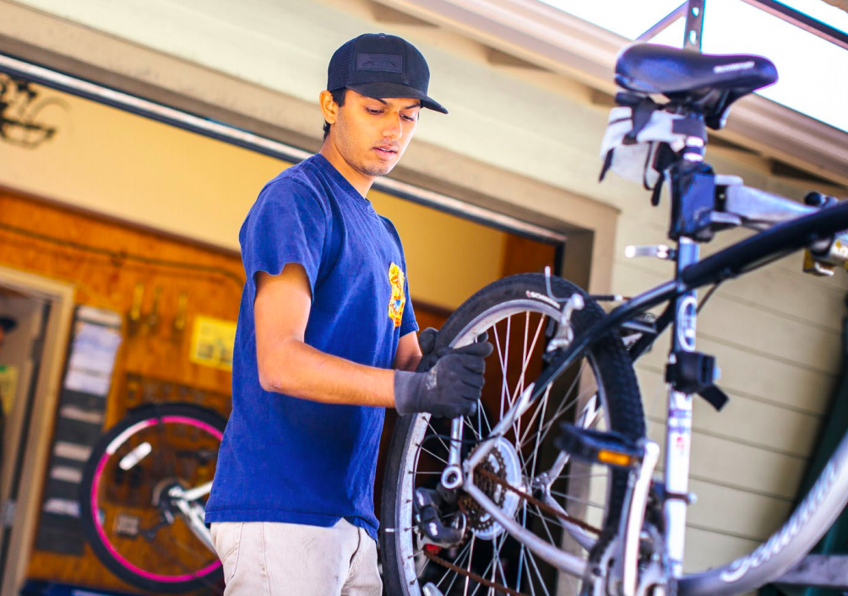
The UC
Carbon Neutrality Initiative
Notes:
Today we’re going to discuss the University of California’s Carbon Neutrality Initiative.
----------------------------NOTE TO INSTRUCTORS---------------------------- Hello! Thank you for taking part in our initiative to educate students about the UC Carbon Neutrality Initiative.
You are welcome to tailor this presentation for your purposes, of course, but please read through the information below to help guide you.
Timing: This presentation takes ~25-30 minutes. It showcases the CNI and explains how the UC System, and your campus, is doing so far.
Active Learning: This presentation includes two easy active-learning exercises. Active learning activities in the classroom are known to increase participation, inclusivity, and learning. https://ceils.ucla.edu/resources/teaching-guides/interactive-teaching/
1) The first exercise is a multiple-choice question. To answer the questions, students can use a simple app called "ABCD Cards" available for free download on their smartphones. Though it is a quick download, to save time, you may request that students come to class having already downloaded it.
https://play.google.com/store/apps/details?id=com.greeneb4.ABCDCards&hl=en_US
https://apps.apple.com/us/app/abcd-cards/id1212769036
Or you can go low-tech and create a set of cards that you hand out. Having everyone use the app or a set of cards it better than asking for “a raise of hands” for each possible answer. With the app everyone answers at the same time so there is much less pressure to publicly get it right and more students will participate. Plus it’s more fun.
2) The second, a Think-Pair-Share activity, requires no technology.
Diversity and Inclusiveness: If you decide to add or drop slides/images, please keep in mind that we have selected images that represent the diverse groups of people engaged in CNI activities across the UCs. This is another method of creating inclusive classrooms.
Suggested Supplemental Reading: If you choose to assign reading with this module, two suggestions are:
UC Bending the Curve Report: https://drive.google.com/file/d/0BxyAT9ZPmxcvblVaVzhEMnhzSU0/view
The latest annual UC Sustainability Report: https://www.ucop.edu/sustainability/policy-areas/annual-reports.html
Formatting: If you have an older version of PowerPoint (.ppt instead of .pptx files) there may be some formatting issues. If you need a .ppt version, just let us know. We do not yet have this presentation in Keynote or Google Slides, though if you require one of those formats, please let us know.
Comments? Send your feedback to Cully Nordby: nordby@ucla.edu
MORE Teaching Resources: The online platform UC-CSU NXTerra is a curated resource for college instructors from across all disciplines and anyone seeking to enhance their teaching and learning about the climate crisis, critical sustainability, and climate justice studies, both inside and outside the classroom. https://www.nxterra.orfaleacenter.ucsb.edu/topics/
Thank you!
Presentation created by the UCLA Institute of the Environment and Sustainability
Nickie Cammisa, Environmental Science and Engineering D.Env. graduate student
Jessica Heckman, Environment and Sustainability Ph.D. graduate student
Cully Nordby, Associate Director
Many thanks to:
Steve Wheeler, Nurit Katz, Matt St. Clair and Ryan Bell for important perspectives and feedback.
Daniele Bianchi and Holly Buck for piloting the module.
Students of Atmospheric and Oceanic Sciences 1 and Environment M1B for valuable comments.
Funding and support provided by the UC CNI and the Faculty Engagement and Education Working Group.
----------------------------------------------------------------------------------------------------------------------------------

Slide 2
Learning Objectives
To increase:
awareness of the Carbon Neutrality Initiative
understanding of carbon neutrality
understanding of the UC System's impact on the climate and actions being taken
awareness of how you can reduce your carbon footprint and get involved
Notes:
The learning objectives for this lesson are to increase your:
awareness of the Carbon Neutrality Initiative
understanding of carbon neutrality
understanding of the UC System's impact on the climate and actions being taken
awareness of how you can reduce your carbon footprint and get involved

Slide 3
Why Carbon Neutrality?
Globally, the climate is getting hotter
We know why this is happening
human carbon emissions → greenhouse effect → climate change
All our individual actions contribute… and there are almost 8 BILLION people on the planet
kingcounty.gov
Notes:
Why Carbon Neutrality? You are all likely very familiar with these concepts, but just to review….
Globally, the climate is getting hotter.
We know why this is happening. Without going too much into the details of atmospheric chemistry…. we know that humans burn fossil fuels which increases carbon emissions. These carbon emissions, in the form of carbon dioxide and methane, act as greenhouse gases that trap energy in our atmosphere. This causes the average global temperature to rise, changing the climate.
All our individual actions contribute... and there are now almost 8 BILLION people on the planet. Highly developed nations are by far the highest carbon emitters, yet everyone is paying the price.
-------------------------
graphic: https://www.kingcounty.gov/services/environment/climate/our-changing-climate/infographics.aspx

Slide 4
Impacts of the climate crisis
More or stronger droughts, heat waves, sea level rise, hurricanes, wildfires, and more, are leading to:
Agricultural disruptions
Ecosystem disruptions
Poorer human health
Climate refugees
The climate crisis disproportionately impacts lower income nations and low-income communities
Notes:
We are facing a climate crisis and are experiencing the impacts already. Some of the impacts are severe and include more or stronger: droughts, heat waves, sea level rise, hurricanes and storms, wildfires, and more…
These impacts are leading to agricultural disruptions, ecosystem disruptions, poorer human health, and even climate refugees--people that must leave their homes because their region is becoming uninhabitable. It is important to note that the climate crisis does not affect everyone equally. Nations that are contributing the most to the climate crisis, including China and the United States, have more financial resources to address these impacts. Whereas small island nations and lower income nations in hotter parts of the world tend to bear the first and the worst impacts while creating the least emissions.
This is also true at the neighborhood scale. The highest burdens fall onto low-income communities, and these are often communities of color. These communities are already experiencing historical and systematic inequities. The climate crisis compounds issues in these communities where there tends to be more pavement, fewer trees and higher average temperatures to begin with, and where people have fewer resources to cope.
To avoid the worst predictions, we need to reverse this trend. Everything we do requires energy and resources, and human society is largely dependent on burning fossil fuels.
Should we be worried about all of this? Of course.
The UC system, however, is turning that worry into action, that is what we’re learning about today. But first, what IS the “UC System”, just how BIG is it?
------
Sources:
https://www.cdc.gov/climateandhealth/effects/default.htm
https://www.nature.com/articles/s41467-019-12808-z
https://scholar.harvard.edu/files/jisungpark/files/paper_nyc_aejep.pdf
https://www.who.int/news-room/fact-sheets/detail/climate-change-and-health

Slide 5
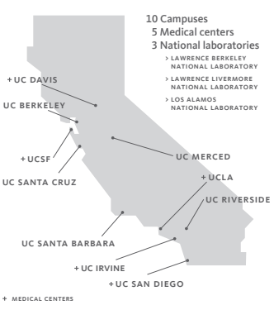
The UC System by the Numbers
10 university campuses
5 medical centers
3 national research
laboratories
$5.84B in research awards
$46B contributed to CA economy
Notes:
The UC system is comprised of 10 university campuses, 5 medical centers, and 3 national laboratories.
Collectively, UC researchers receive $5.84 billion dollars in research awards annually
And overall we contribute over $46 billion dollars to the CA economy each year……..
--------
Source:
https://www.universityofcalifornia.edu/infocenter
https://ucop.edu/institutional-research-academic-planning/_files/uc-facts-at-a-glance.pdf

Slide 6
The UC System by the Numbers
10 university campuses
5 medical centers
3 national research
laboratories
$5.84B in research awards
$46B contributed to CA economy
..and over 600,000 students, staff, and faculty!
Notes:
……. Altogether, there are over 600,000 people that make up the UC system, 47% of which are students.
--------
Source:
https://www.universityofcalifornia.edu/infocenter
https://ucop.edu/institutional-research-academic-planning/_files/uc-facts-at-a-glance.pdf

Slide 7
There are nearly 20,000 cities in the U.S.
If the UC System were a city,
we would be the ___ largest city.
A) 6th
B) 30th
C) 127th
D) 306th
Notes:
To put our population size in context, let’s do a quick quiz… Please pull out your phones and open your ABCD Cards app.
There are nearly 20,000 cities in the U.S.
If the UC System were a city, we would be the ___ largest city.
6th
30th
127th
306th
Please select your answer and hold it up your phone or tablet….
[Note to instructor: Wait until you see most phones held up, then comment on what you see.. For example:
“I see a lot of Bs and Cs,… a few As and Ds…”]
Ok, let’s see …..

Slide 8
There are nearly 20,000 cities in the U.S.
If the UC System were a city,
we would be the ___ largest city.
A) 6th
B) 30th!
C) 127th
D) 306th
Notes:
Amazingly, if the UC system were a city, we would be the 30th largest in the entire country. This means, collectively, our population is bigger than each of the following cities:
Baltimore, Maryland
Fresno, California
Sacramento, California
Atlanta, Georgia
Kansas City, Missouri
Miami, Florida
Oakland, California
Minneapolis, Minnesota
Cleveland, Ohio
New Orleans, Louisiana
Pittsburgh, Pennsylvania
...and many thousands more.
We have a huge impact.
--------
Source: https://en.wikipedia.org/wiki/List_of_United_States_cities_by_population accessed 08/25/20

Slide 9
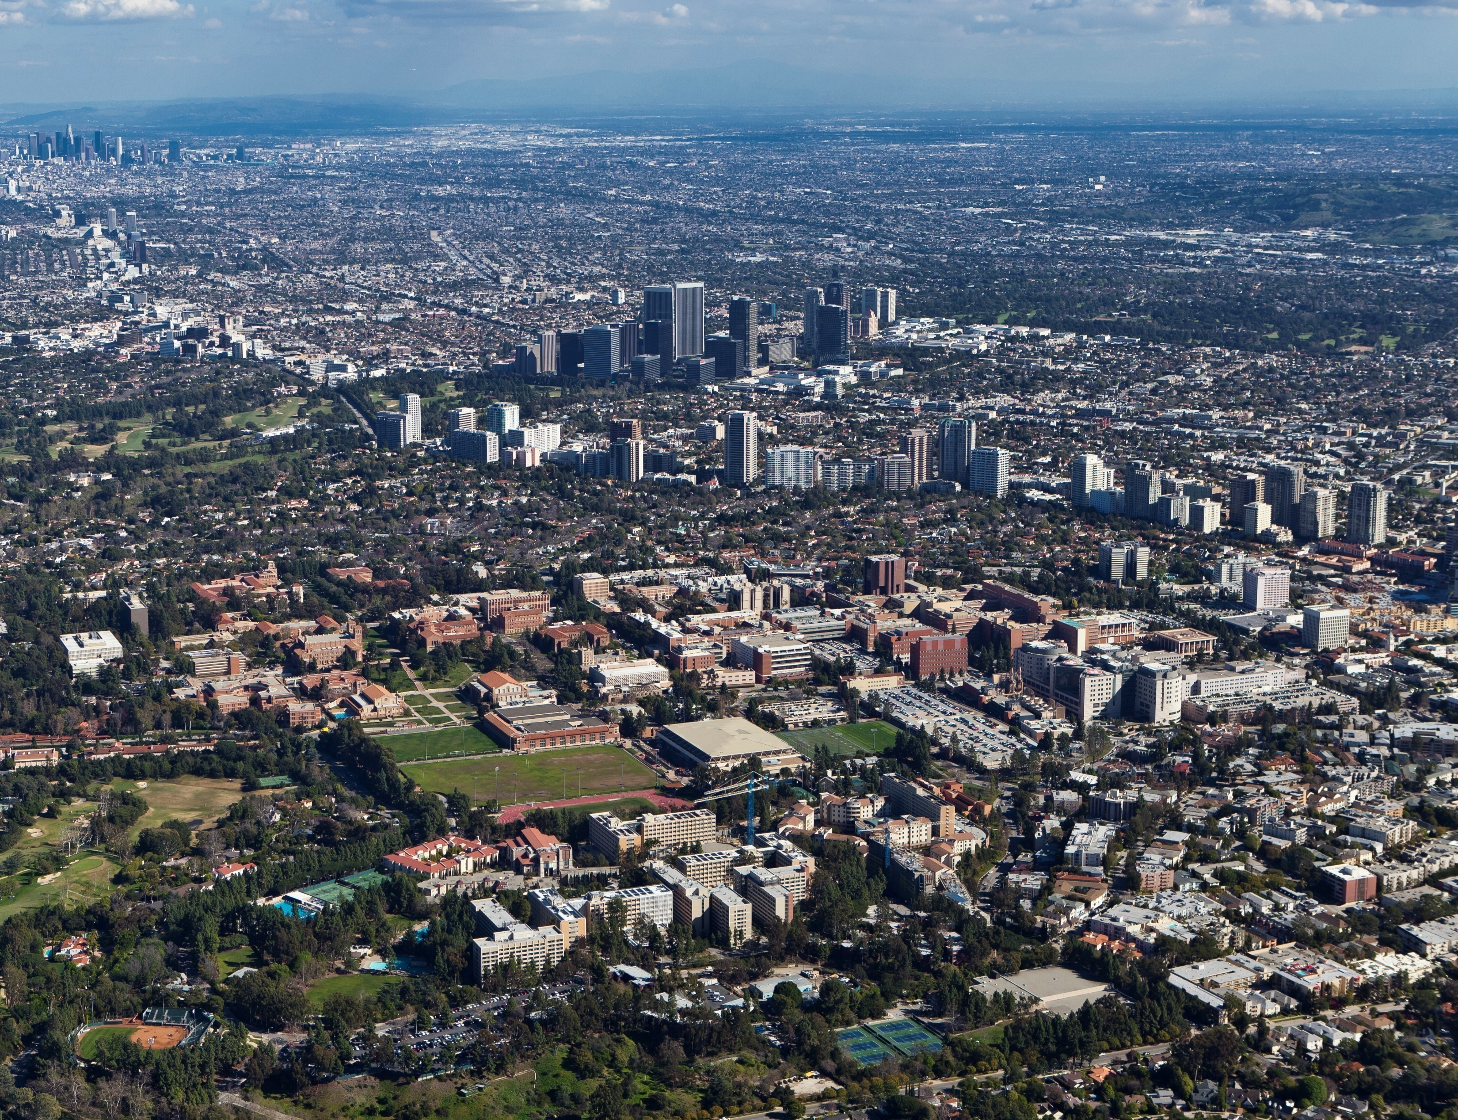
Notes:
Here is a photo of our campus, UCLA is in the foreground. With a daily population of 80,000 people and over 200 buildings, we are like a small city ourselves.
With such a large system of campuses like this, medical centers, labs, and more, comes a large amount of carbon emissions.
We generate emissions from the energy used to light and heat our buildings, fuel our buses, heat water for showers in the gyms, run computers and lab equipment, and cook food in the eateries.
Everything we do uses energy and resources.
So, what are we doing about this?

Slide 10
What is the Carbon Neutrality Initiative?
Notes:
The UC system committed to carbon neutrality in 2007 but in 2013, Janet Napolitano, then the president of the UC system, decided boldly that the climate crisis was urgent, and we needed to get there sooner.
She said we need to figure out a way to do all that we do, but in a smarter, sustainable way.

Slide 11
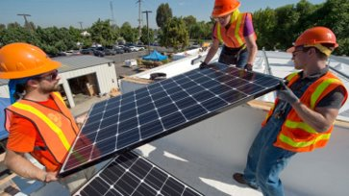
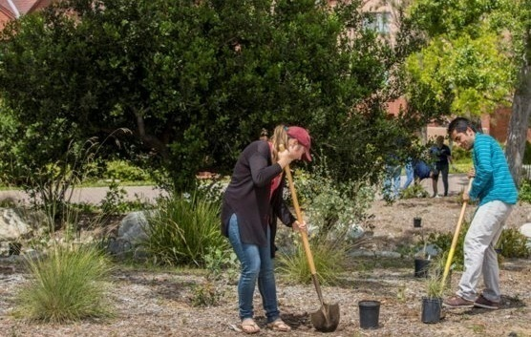
UC Carbon Neutrality Initiative
What's the Goal?
Carbon Neutral by 2025
Why?
As a public institution, we must be an example
and set the standard for sustainability
Notes:
The goal of the Climate Neutrality Initiative, or CNI, is for the entire UC system to be carbon neutral by 2025. Meaning no net release of carbon emissions into the atmosphere.
As one of the leading public institutions in the world, representing California, one of the largest economies in the world, we must be an example and set the standard for sustainability.
We have a responsibility to demonstrate that it is possible to reduce emissions and become carbon neutral. It is important to note that the CNI is just one piece of a much larger movement toward sustainability for the UC system. Other sustainability goals include: sourcing sustainable food, goods and materials; reducing water use; and achieving zero waste. I’ll give you resources at the end of this presentation to learn more.

Slide 12
How do we measure carbon neutrality?
By 2025, achieve neutrality for:
Scope 1 = Direct emissions
Campus transportation fleet, natural gas, and fugitive emissions
Scope 2 = Indirect emissions
Purchased electricity
Notes:
How do we measure carbon neutrality?
Emissions are divided into three categories, or “scopes”.
The CNI states that by 2025, the UC system will achieve carbon neutrality in scopes 1 and 2.
Scope 1 is Direct emissions. This includes emissions from:
the campus transportation fleet including buses and shuttles
on-campus electricity generation such as burning natural gas in our power plant, and
fugitive emissions which are gases or vapors leaking from equipment or other unintended release of gases.
Scope 2 is Indirect emissions. These are emissions generated from the electricity we purchase from a local utility provider. Just like in your homes, each university has an electricity bill—and there are emissions associated with where that electricity comes from. For UCLA, our utility provider is the Los Angeles Department of Water and Power.

Slide 13
How do we measure carbon neutrality?
By 2025, achieve neutrality for:
Scope 1 = Direct emissions
Campus transportation fleet, natural gas, and fugitive emissions
Scope 2 = Indirect emissions
Purchased electricity
By 2050, achieve neutrality for:
Scope 3 = Other indirect emissions
Student, faculty and staff commutes and business air travel
Notes:
We also have a goal for Scope 3 emissions. By 2050, we aim to achieve neutrality for:
other indirect emissions which includes all the emissions generated by everyone commuting from home to their UC destination AND from university-funded air travel.
We hope to get there well before 2050.

Slide 14
How are we
going to achieve
carbon neutrality?
Notes:
How are we going to achieve neutrality?
We are using many approaches. We will briefly cover three of the many strategies in more detail..

Slide 15
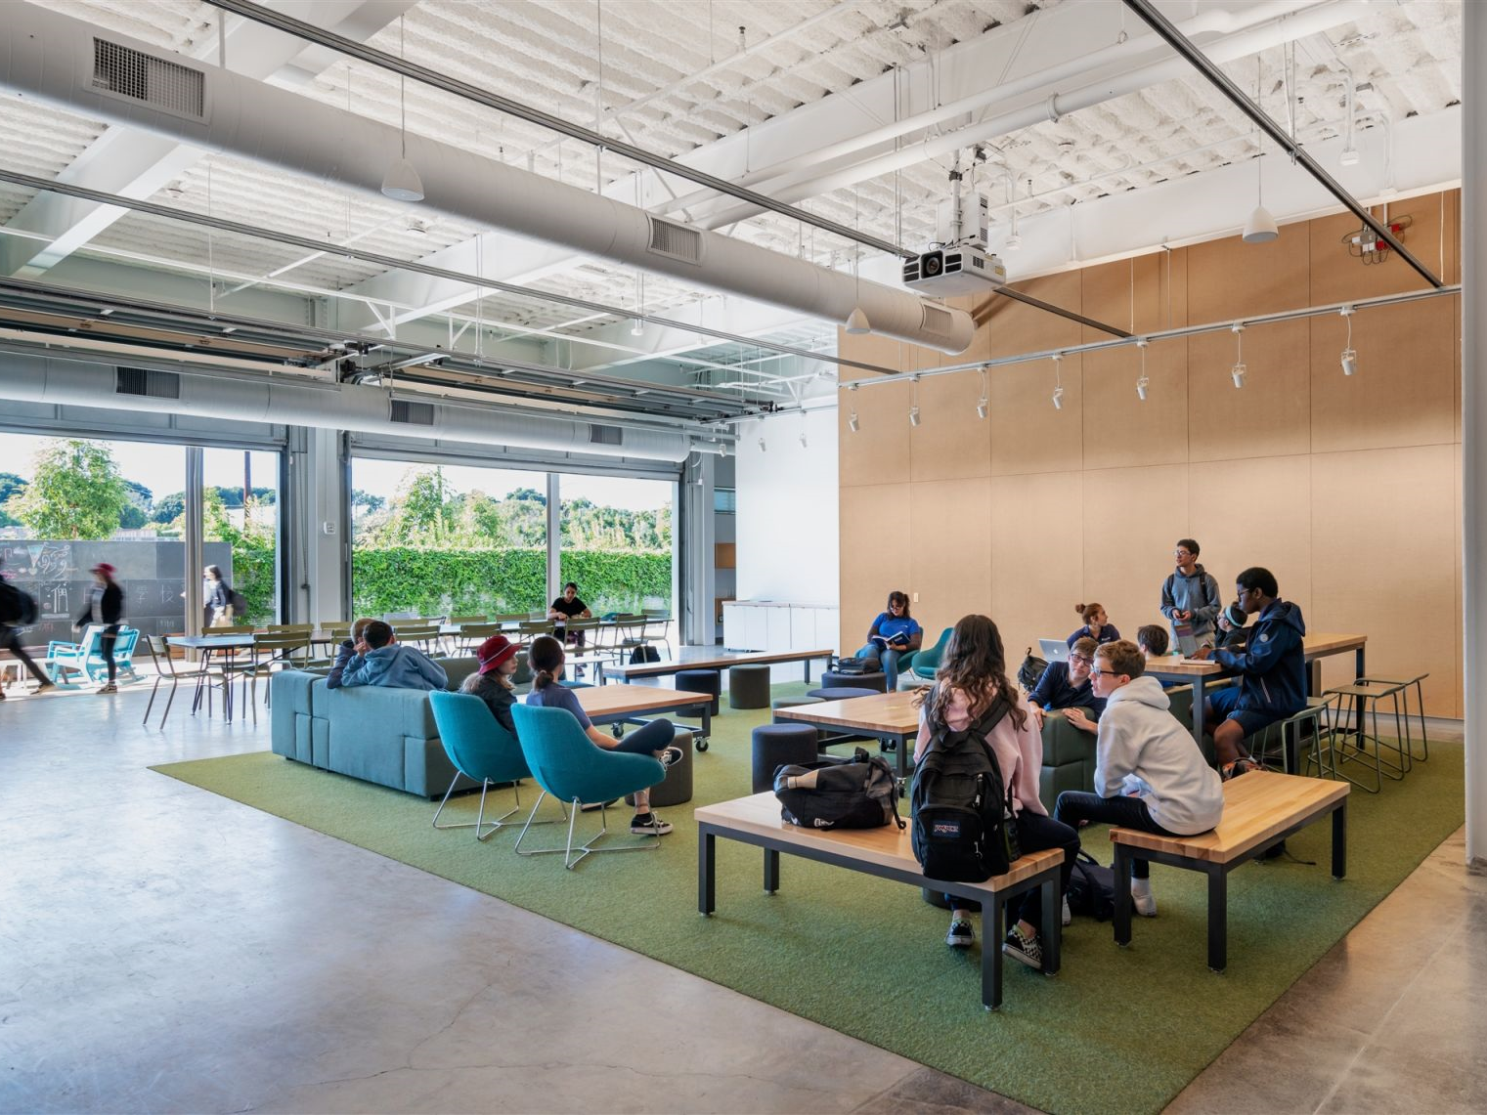
Efficiency
Notes:
Our first approach is to reduce the need for energy and electricity through EFFICIENCY.
We are making our current systems and structures work smarter. The UC has invested over $250 million in just the past 5 years in energy efficiency projects. These investments have led to a direct reduction in climate-warming emissions.
Now all new construction must be designed with efficient systems.
Some examples are:
… Green Buildings, which are certified by the U.S. Green Building Council, such as the Geffen Academy building at UCLA, shown here.
…Reducing fossil fuel use by electrifying campus vehicles,
...Green Lab Certification Programs, making research labs more efficient by replacing old appliances and instilling energy-saving behaviors,
…and teaching sustainable habits to students, faculty, and staff.

Slide 16
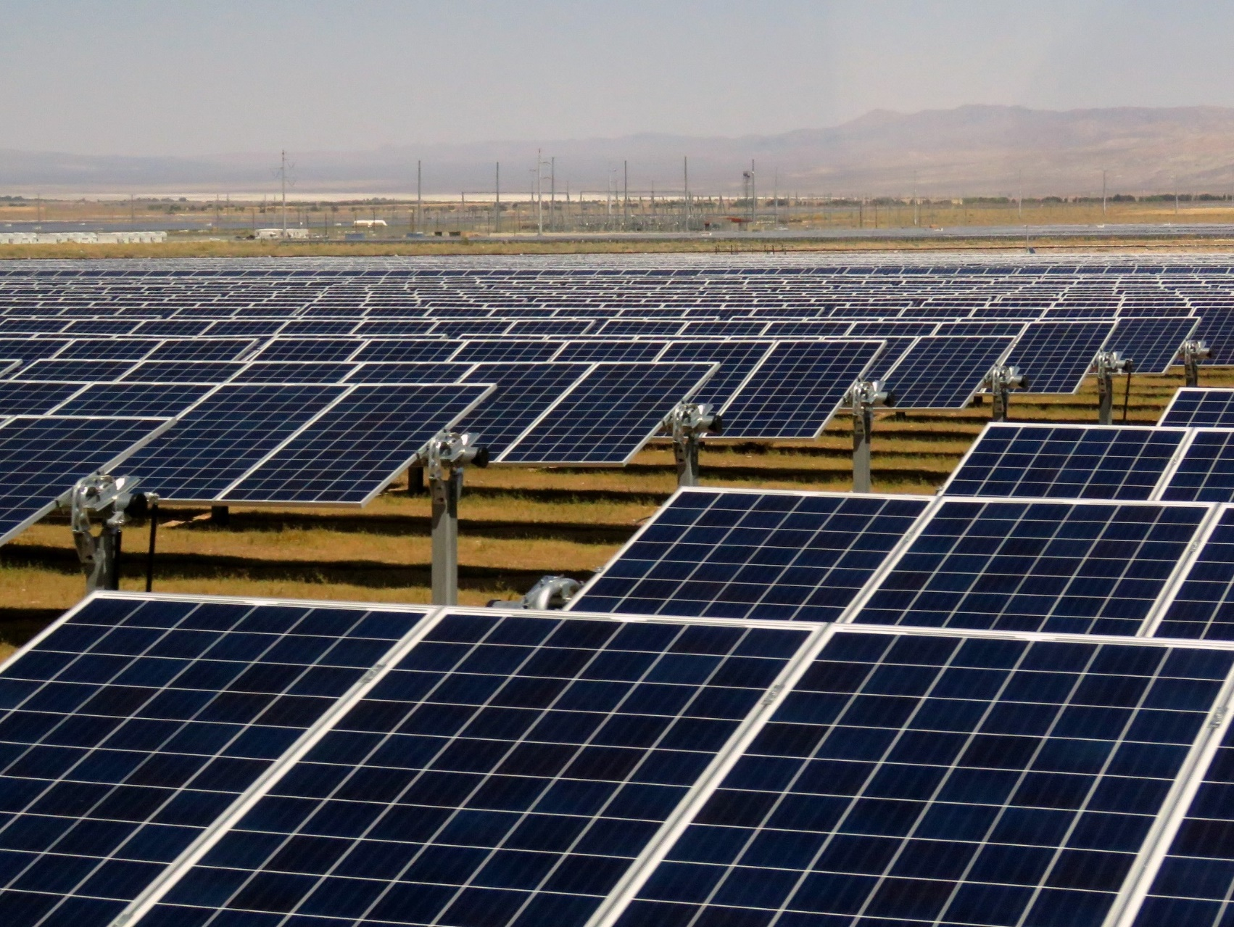
Renewables
Notes:
The next step in achieving neutrality is switching to renewable energy sources, or energy sources that can be replenished, unlike fossil fuels.
These projects can be implemented right on campus, such as:
switching natural gas power plants to running on renewable biogas
installing solar panels on our roofs
and electrification of campus vehicles that get us off fuels all together
We also invest in off-campus renewable sources:
The UC has invested in the solar array shown here. This array in Fresno County accounts for 14% of UC electricity use.
We also procure hydroelectric power from nearby dams
And purchase more clean energy from our power providers.
With more projects like these, we can get to our goal of 100% clean energy.
-----------------------
https://www.ucop.edu/sustainability/sustainability_report_2019_f2.pdf

Slide 17
Offsets
Notes:
The last step in achieving our goal is to offset our remaining emissions.
Even with increasing efficiency and making the switch to renewables, we use so much energy that we may still need carbon offset projects. These projects reduce carbon emissions elsewhere in the world.
These offsets can be thought of as "certificates" of mitigated emissions and are used only after we’ve exhausted our options for directly reducing emissions.
One example is large scale reforestation projects, like the project UC faculty Kevin Njabo and Tom Smith are working on in Cameroon.
We also offset emissions closer to home in California, by planting trees on UC properties, by capturing landfill gas for re-use, and by working with nonprofits to improve energy efficiency in residential communities surrounding campuses.
Of course, we are not only working to achieve carbon neutrality ourselves, we are helping to make this clean energy future possible by leading the way in research into sustainable energy sources and technology, carbon sequestration, efficient design and more…

Slide 18
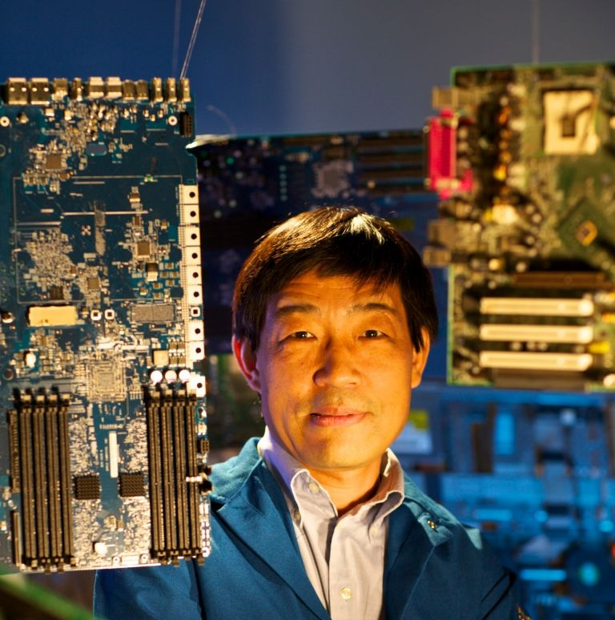
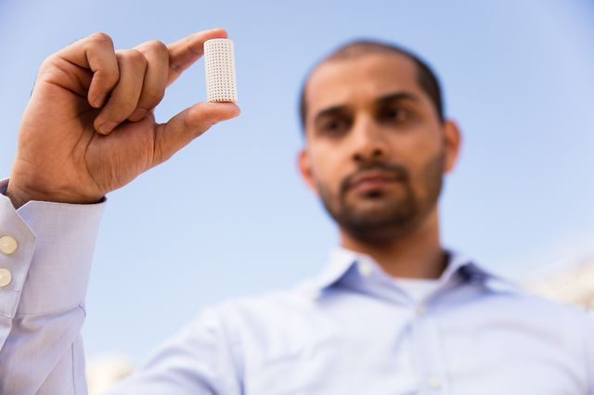
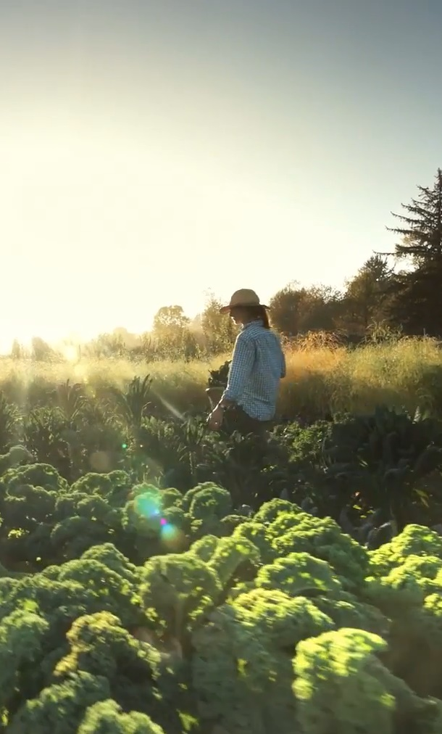
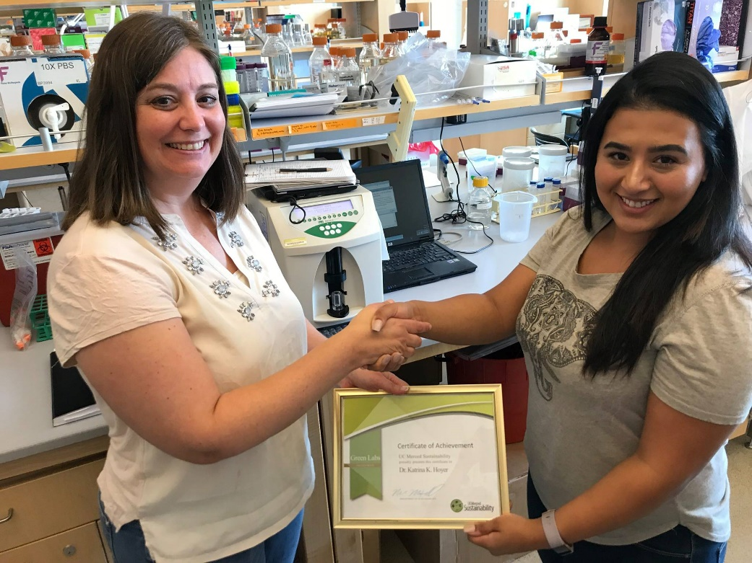
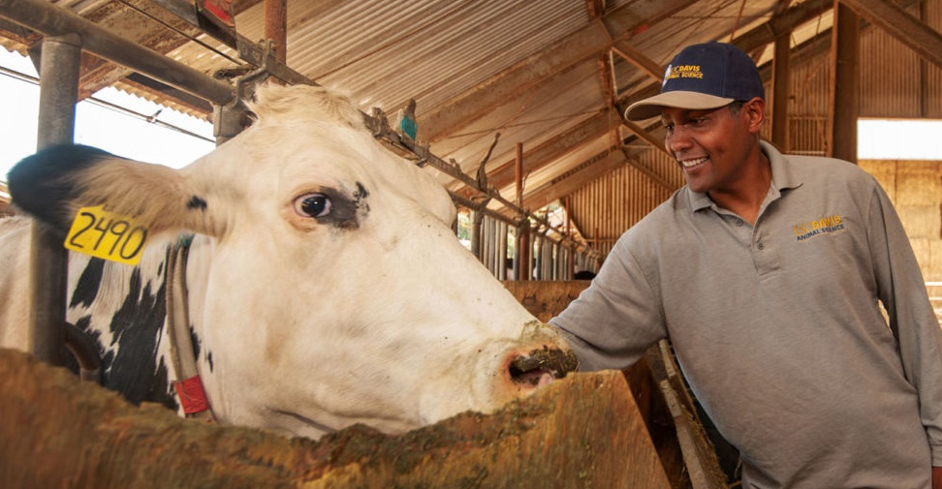
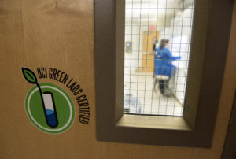
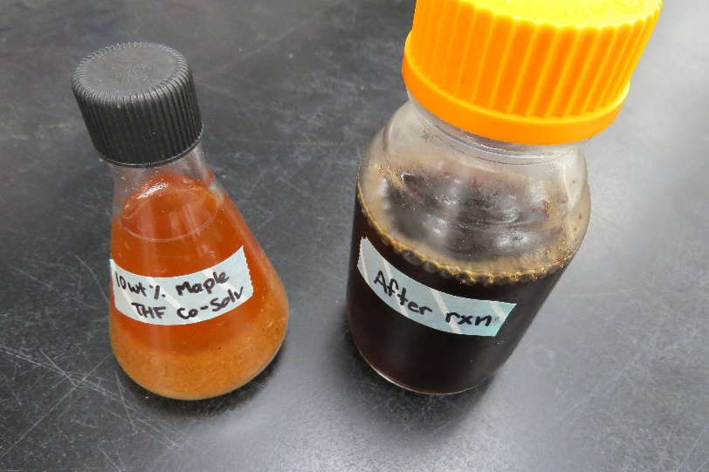
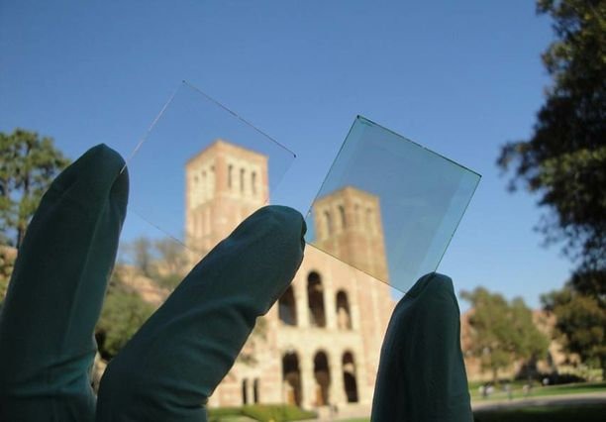
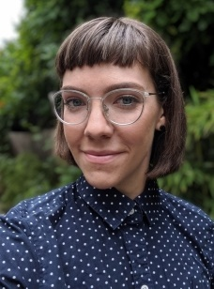
Notes:
The UC campuses serve as living laboratories and researchers are finding new ways to reduce energy needs and mitigate emissions.
Here are just a handful of examples of some of the exciting research happening across the UCs. These are the types of projects you could get involved in here on campus!
There are researchers finding ways to….
embed CO2 in concrete
create transparent solar film
feed cows seaweed to reduce methane emissions
farm seaweed
store carbon in soil
make surfboards out of algae
….and much more…
-----------------
Examples (from left to right)
Row 1:
UCLA embedding CO2 in concrete http://newsroom.ucla.edu/stories/reimagining-co2:-ucla-team-advances-to-carbon-xprize-finals
UC Santa Cruz solar greenhouses https://news.ucsc.edu/2016/05/solar-greenhouse.html
UC Riverside efficient computing https://ucrtoday.ucr.edu/34997/_u0c3390-1
UC Berkeley managing soil for carbon storage - still from https://www.youtube.com/watch?v=Cq4DL-eZhro
Row 2:
UC Merced Green Labs program https://www.facebook.com/sustainUCMerced/photos/a.411820734144/10155265673464145/?type=3&theater
UC Merced researching use of biochar instead of manure to reduce methane https://news.ucmerced.edu/news/2019/researchers-hope-tackle-methane-emissions-manure-through-use-biochar
UC Davis feeding seaweed to cows to reduce methane https://caes.ucdavis.edu/news/articles/2018/may/can-seaweed-cut-methane-emissions-on-dairies
Row 3:
UC San Diego making surfboards out of algae https://ucsdnews.ucsd.edu/feature/surfing_into_a_greener_future
UC Riverside enhancing biofuels https://ucrtoday.ucr.edu/24072
UC Irvine green labs program https://news.uci.edu/2018/04/20/powering-down/
Row 4:
UC Santa Barbara seaweed farming https://www.news.ucsb.edu/2019/019595/charismatic-carbon
UCLA transparent solar film https://newsroom.ucla.edu/releases/ucla-researchers-double-efficiency-247383
UC Santa Barbara solid state lighting https://www.news.ucsb.edu/2019/019648/royal-fellowship

Slide 19
How Are We Doing?
Notes:
How is the UC System doing? Are we meeting the goals of the CNI?

Slide 20
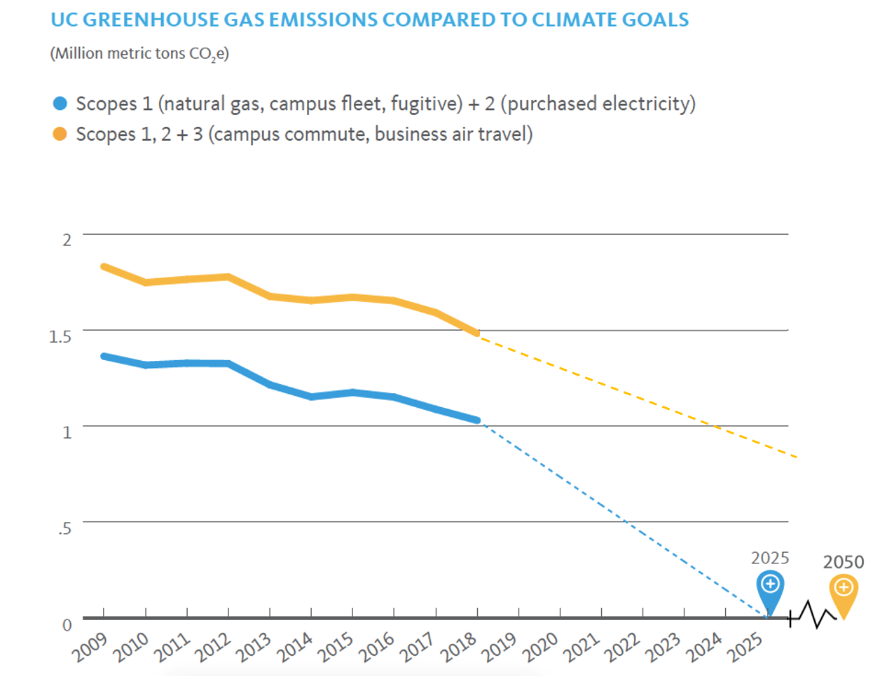
Adapted from: UC Annual Report on Sustainable Practices (2019)
Notes:
We are going in the right direction! Here is a graph showing all UC emissions combined.
We have time along the x-axis, in years, and on the y-axis we have millions of metric tons of CO2e. CO2e is carbon dioxide equivalent and it used as a way of expressing the impact of different greenhouse gases in terms of the amount of CO2 that would create the same amount of warming. In this way we have one, combined metric for all our emissions.
From 2010 through 2017, the UC System reduced emissions by 5%. This is an accomplishment especially considering that this reduction was achieved despite an increase in the number of students and full-time employees of nearly 16% during that same time period.
We’ve done well, but …… look at the slope of the dotted lines. They are steep. And growth is projected to increase even more across the UCs so we've got a lot of work to do to achieve neutrality, and we need all hands on deck.
__________
Sources: %s were calculated using # of students and FTE from UC Information Center (https://www.universityofcalifornia.edu/infocenter) and emissions data provided by Ryan Bell of UCOP

Slide 21
Top challenges at the UC System level
Funding & financing
Energy efficiency & conservation
New buildings
Communication & change management
Energy supplies
Medical centers
Notes:
As you saw from the slopes of the graph, we are not quite on track to meet carbon neutrality goal by 2025. Rather, we are on track to reach that goal around 2040. To reach the goal, the UC System will need to reduce emissions by the equivalent of more than 1 million metric tons of carbon dioxide.
This is due to challenges in the following areas:
Funding & financing: Large upfront costs are a barrier, even for programs that pay for themselves; the current budgeting technique is more short term and focused on start-up costs. This hides long-term savings (vs life-cycle cost analysis, which takes into consideration the cost of a project from construction to end-of-life)
Energy efficiency & conservation: To meet our goals, the UC needs to hire more staff who are trained in energy efficiency. For example, campuses and parts of the health system could attain 50% or more improvement in energy efficiency through energy retrofits like upgrading to more efficient lighting and appliances.
New buildings: Campuses continue to grow; there is not yet a system-wide policy to address increased emissions that come with new buildings.
Communication & change management: We must do more to engage students, faculty, & staff (the goal of this module).
Energy supplies: The amount of renewable energy available on the market is not always enough to meet each campus’ needs.
Medical centers: Regulatory requirements and prioritizing of patient safety limits our ability to reduce emissions.
___________
Sources: UC Overcoming Barriers to Carbon Neutrality Report, 2017; Overcoming Organizational Barriers to Carbon Neutrality: Lessons from the UC Experience (Carlson and Forgie, 2018) https://escholarship.org/uc/item/34m0j8j6

Slide 22
How is UCLA Doing?
Notes:
So, how are we doing here at UCLA?

Slide 23
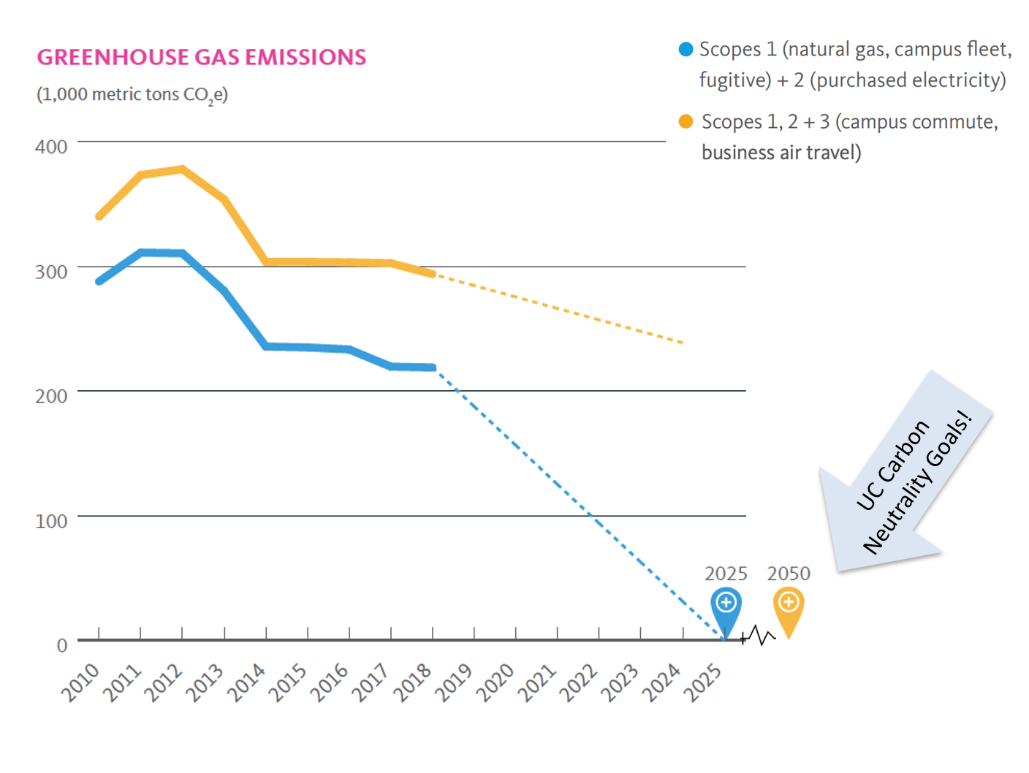
Notes:
Similarly to the UC system’s progress, UCLA has been decreasing emissions while continuing to grow as a campus.
Even with the progress we’ve made, we can see that there is a lot of work to be done to reduce our emissions and get to our goal of carbon neutrality by 2025. We are using the same three methods…

Slide 24
How is UCLA Doing?
We're reducing our need for energy through efficiency...
Notes:
We're reducing our need for energy through efficiency...

Slide 25
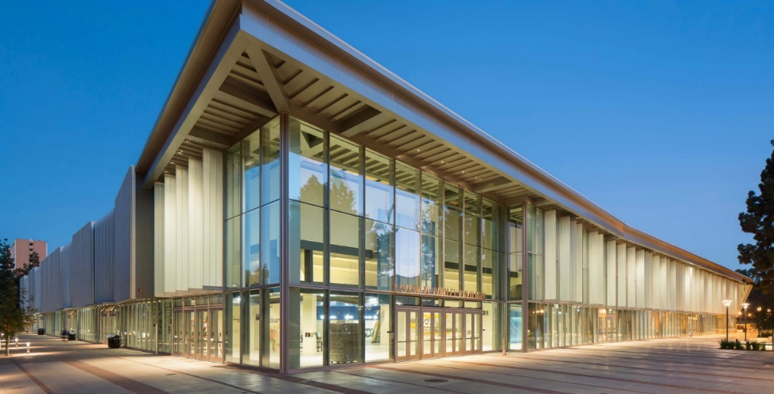
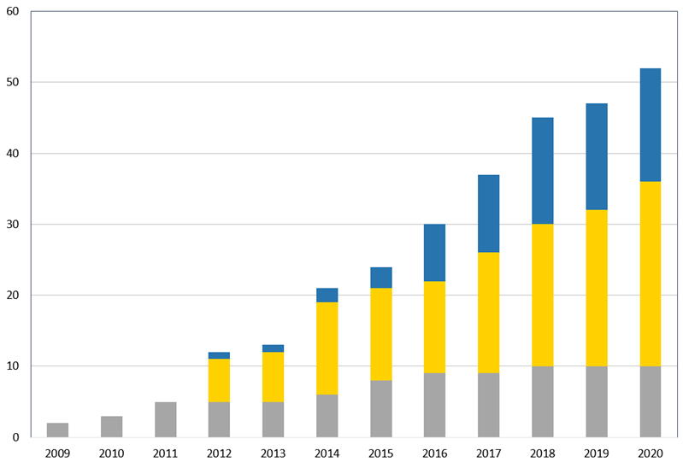
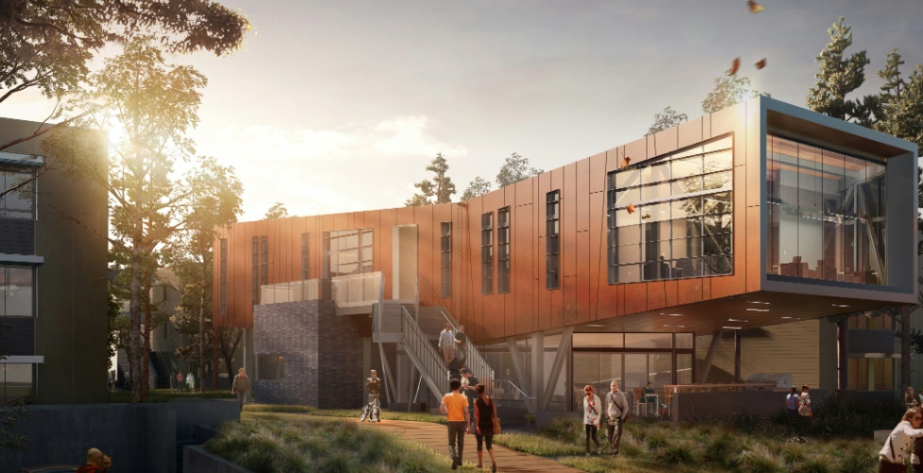
Notes:
UCLA has kept our greenhouse gas emissions mostly level despite the campus growing by millions of square feet. Part of how we did that is making sure the new buildings we build use less energy.
All new buildings and major renovations must be certified LEED Silver or higher. LEED is the U.S. Green Building Council’s rating system – it stands for Leadership in Energy and Environmental Design. On the graph you can see how many more LEED projects we have at UCLA - now more than 50 projects, 16 of which are the highest level- Platinum.
Some examples of LEED buildings you may have visited on campus shown here are Pauley Pavilion, the Luskin Conference Center, or Saxon Suites.
Through our Smart Buildings and Labs program we are focused on even deeper energy efficiency measures in existing buildings. A recent project at Broad Art Center reduced the energy use of that building by more than 40%.
In addition, we have a long history of investing in energy retrofits for existing buildings. Systemwide, the Statewide Energy Partnership program has enabled the university to invest in energy efficiency projects that have saved 170,000 metric tons of greenhouse gas emissions while avoiding $166 million in energy costs
-----
Photos:
http://www.capitalprograms.ucla.edu/
http://www.capitalprograms.ucla.edu/Projects/Archive
Source: UC Overcoming Barriers to Carbon Neutrality Report, 2017

Slide 26
How is UCLA Doing?
We're reducing our need for energy through efficiency...
using more renewables instead of fossil fuels...
Notes:
We’re using more renewables instead of fossil fuels...

Slide 27
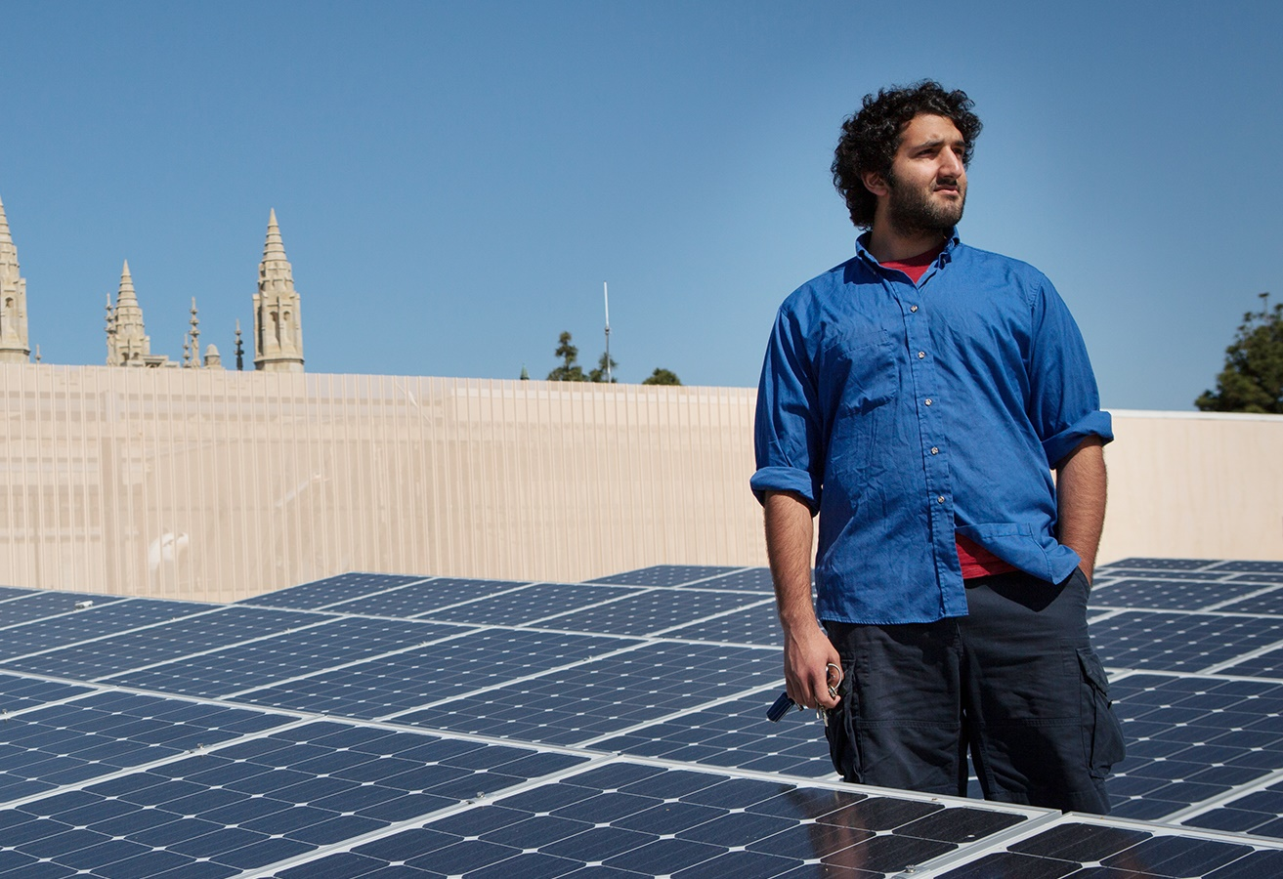
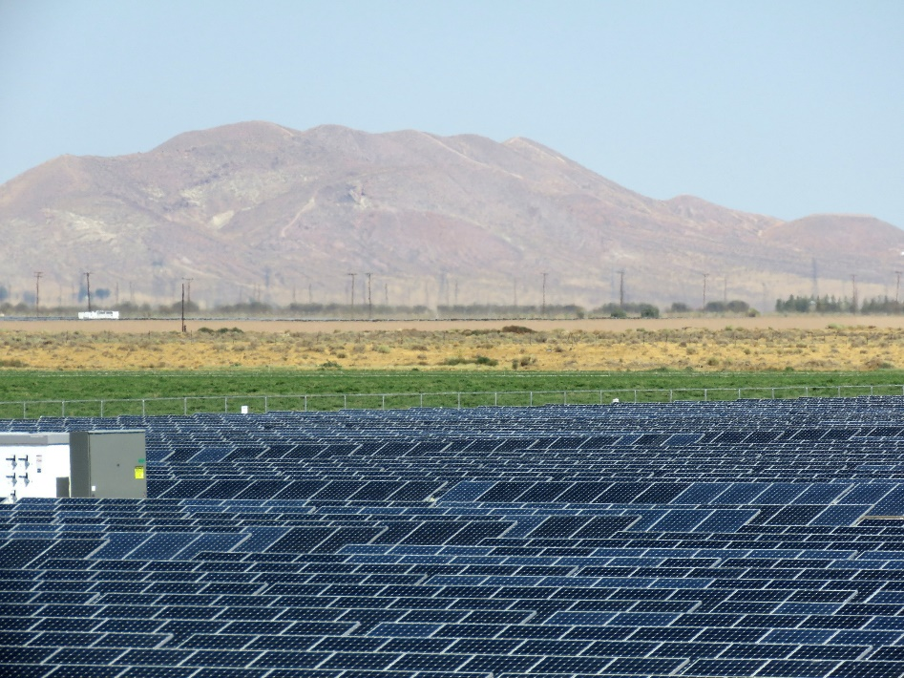
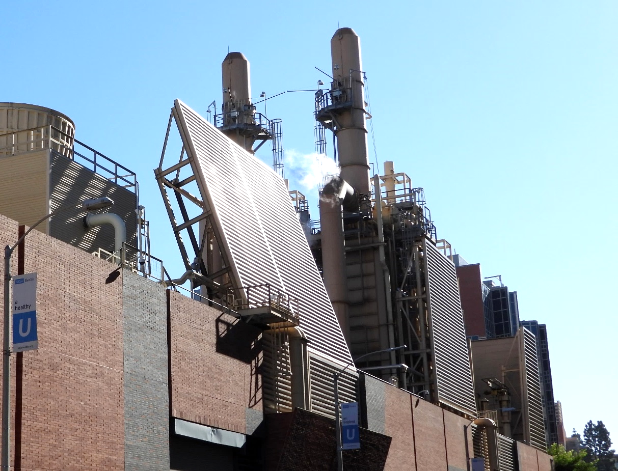
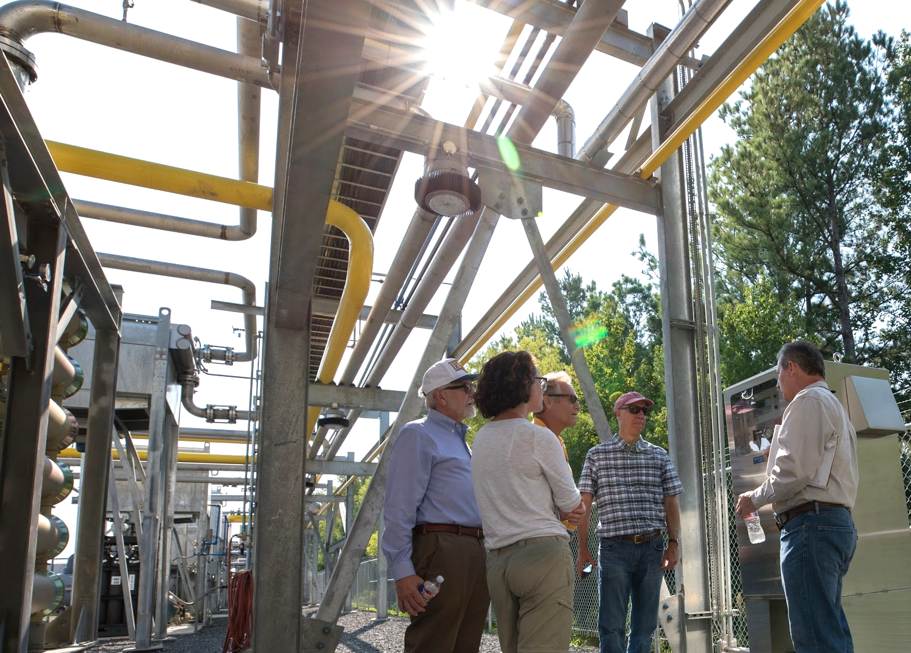
On-site solar
Off-site solar
Cogeneration Plant
Biogas
Notes:
We have…
On site solar – The solar array on top of Ackerman, shown here, was a student project. We also have a solar-powered micro grid at parking structure 9 which is connected to the Smart Grid Energy Research Center in Engineering. We have solar umbrellas, solar water heating, and more. We will soon be installing much more solar through a City of LA Feed-in Tarif program – this program was designed with the help of faculty in our Luskin Center for Innovation.
Off-site solar - Because UCLA is so densely developed, we don’t have room for a lot of renewables on campus, we need off-site projects as well. In 2019 our campus signed a historic agreement with the LA Department of Water and Power which will provide us with 10 megawatts of solar energy. This covers about 16% of the electricity we use.
Cogeneration Plant - UCLA became a leader in reducing emissions by building a cogeneration plant (Co-gen for short) back in 1994. The plant, near the corner of Westwood Blvd. and Charles Young Dr., burns natural gas to produce electricity. The waste heat generated from that process is captured and then converted into steam and chilled water used to heat and cool campus buildings. You have probably noticed what looks like a lot of gases rising from the vicinity of the hospital- that's actually just steam from the co-gen plant! This process is extremely efficient and produces roughly half the emissions of traditional power sources.
Biogas - The Co-gen was designed to run on natural gas so it can also run on biogas--a renewable form of natural gas. UCLA has been a leader in using biogas by sourcing it from the nearby Mountain Gate landfill for over two decades. That supply has dwindled. We now need to find new sources of biogas and the UC system is working on developing biogas projects to supply multiple campuses. The bottom right photo shows one of the landfill gas plants that was developed for UC.

Slide 28
How is UCLA Doing?
We're reducing our need for energy through efficiency...
using more renewables instead of fossil fuels...
and offsetting our remaining emissions
Notes:
…and offsetting our remaining emissions

Slide 29
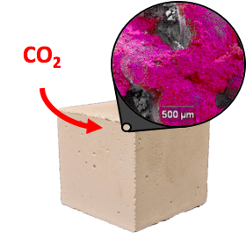
Carbon-neutral concrete offsets emissions
Notes:
We’ve already mentioned the UCLA ebony reforestation project in Cameroon that will offset emissions.
Carbon upcycling, which means using CO2 as an ingredient in a process or product, is another way to generate offsets.
At UCLA, a team of engineers, scientists and policy experts has invented a near carbon-neutral version of concrete, a common building material used worldwide. They remove CO2 from the atmosphere and use it as an ingredient in the concrete, reducing the amount of CO2 in the atmosphere. This is a creative type of offset that also makes the process of constructing with concrete carbon-neutral.
To reach carbon neutrality, UCLA purchases other offsets that support projects verified by the CA Air Resources Board that oversees climate initiatives for the State of CA.
---------------------
http://newsroom.ucla.edu/stories/reimagining-co2:-ucla-team-advances-to-carbon-xprize-finals

Slide 30
Challenges for UCLA
Natural gas co-generation plant emissions
Space constraints
Continual growth of campus
Deferred maintenance backlog
Competing demands & interests with limited budget
Notes:
Our campus faces many of the UC-wide challenges mentioned earlier, and there are some challenges that are more significant for our campus:
Natural gas co-generation plant emissions - The co-gen plant is more sustainable than other energy options, but it presents a significant challenge in achieving carbon neutrality. To achieve carbon neutrality, UCLA will need a reliable, low cost source for biogas – a renewable form of gas.
Space constraints: UCLA is the largest UC campus in terms of population, but the smallest in terms of acreage. We do not have space to install as many solar panels, wind turbines or an onsite biodigester that could help us meet our energy needs.
Continual growth of campus: The number of students at UCLA has increased 50% over the last two decades and we now have over 25 million square feet of building and structure space on the main campus. Keeping up with this growth is a major challenge.
Deferred maintenance backlog: Not only is UCLA growing, but we also have a substantial backlog estimated at $1.5 billion worth of needed repairs and upgrades, for example air conditioning equipment that is past its intended life span.
All of this, and more, adds up to a situation where we have competing demands and interests, and we also have a limited budget. There are always trade offs, so how do we make these decisons, how do we prioritize our needs? These are tough choices.
___
Sources: UC Overcoming Barriers to Carbon Neutrality Report, 2017; Overcoming Organizational Barriers to Carbon Neutrality: Lessons from the UC Experience (Carlson and Forgie, 2018) https://escholarship.org/uc/item/34m0j8j6
https://www.apb.ucla.edu/campus-statistics/enrollment
https://www.facilities.ucla.edu/services

Slide 31
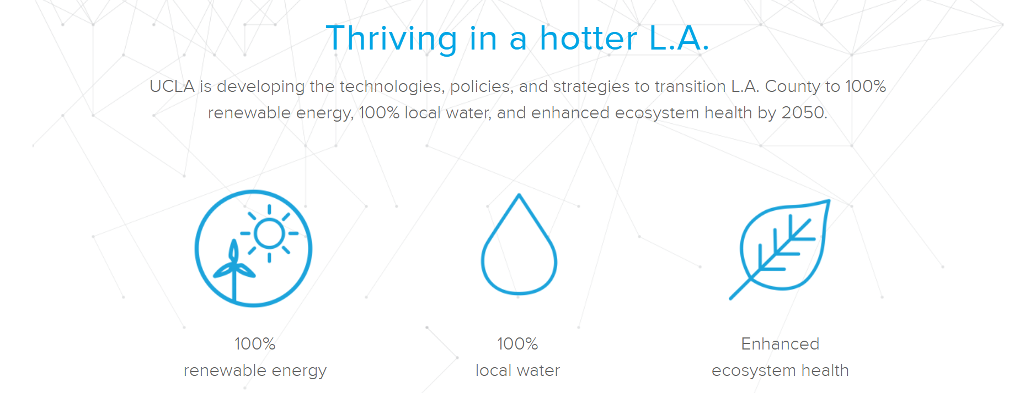
grandchallenges.ucla.edu/sustainable-la/
Notes:
UCLA is committed to addressing challenges beyond our campus borders, as well….
The UCLA Grand Challenges initiative connects faculty, students and supporters from all disciplines to work together, adopting a holistic approach to solve critical issues.
The Sustainable LA Grand Challenge coordinates more than 150 UCLA faculty, researchers, and scholars around the goal of transitioning Los Angeles County to
100% renewable energy
100% local water
and enhanced ecosystem health by 2050.
You can learn more about the impressive array of ongoing research and how to get involved at their website: grandchallenges.ucla.edu/sustainable-la/

Slide 32
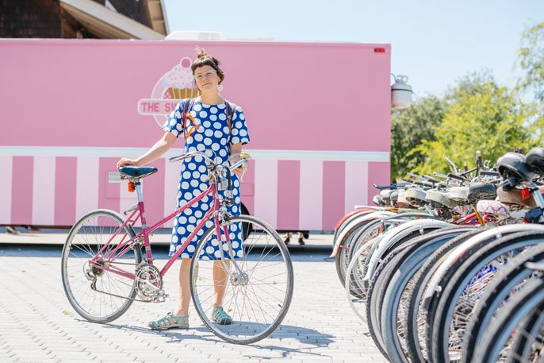
We need your help
to achieve carbon neutrality!
Notes:
While all these efforts are inspiring and hopeful, we need your help to achieve carbon neutrality.
That's why we are doing this presentation- because we need all students, staff, and faculty to understand and to get on board to help with this ambitious, but achievable goal.

Slide 33
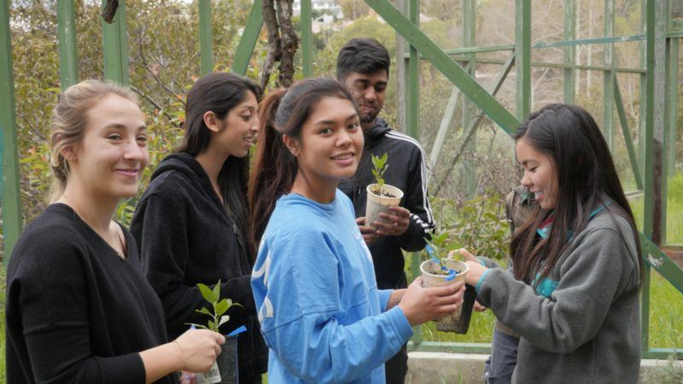
THINK, PAIR, SHARE
What can YOU can do to help your campus achieve carbon neutrality?
Notes:
[Note to instructor: This active-learning exercise can be done in ANY SIZE class whether it’s 10 or 400 students. It takes 7-8 minutes, or longer, depending on how many pairs you want to hear from in the sharing portion. The goal here is to have students think about this personally, share ideas with each other, and hopefully get inspired with more ways to become more sustainable in their own lives. Here is a great page from UCLA CEILS about active-learning techniques: https://ceils.ucla.edu/resources/teaching-guides/interactive-teaching/
Now what I’d like you to do is think about this question – What can YOU do to help our campus achieve carbon neutrality?
We’ll do this as an exercise called Think, Pair, Share. You will first think about this question, silently, for 1 min. You can write down your ideas if you like. Then you will pair up, in groups of 2s, or 3s if needed, and discuss your ideas with one another. Then we’ll come back all together and share our ideas.
Ok, so first think about this question to yourself – for 1 minute.
[set a timer. At ~15 seconds left – let them know to finish up ideas soon – “You’ve got 15 seconds left – get creative!”]
Now I want you to pair up and talk with your neighbor, share your ideas, you’ve got 2 minutes. Everyone needs to be in a pair, you can have a group of three if needed.
[set timer again – the whole class should be talking! Again, give them a 10-15 second warning. You can walk around and listen in; see how it’s going….]
Ok, let’s come back together… Who would like to share some of the ideas from their group?
[WAIT for several hands to go up. Then start calling on people to share ideas and have a class discussion about ways students’ actions can help campuses achieve neutrality. If you can, walk around the room, pass a microphone so everyone can hear. What can individuals do? What can students start?]
-----
Photo: https://www.ioes.ucla.edu/article/ucla-student-wins-award-for-climate-action-and-social-justice/

Slide 34
Impactful ways to reduce your carbon footprint
Eat less meat, especially beef
Eat local, fresh food in season
Walk, bike, use public transit & carpool
Fly less
Buy energy efficient electronics & appliances
Consume & waste less
Notes:
That was great – you all thought of some wonderful ideas.
Here is a list of some of the most impactful things you can do, personally, to reduce your carbon footprint, we heard some of these already…
Eat less meat, especially beef which has a high carbon footprint compared to other foods.
Eat local, fresh food in season to reduce the need for transportation, processing, canning, and refrigeration or freezing
Walk, bike, use public transit & carpool – all of which reduces your need for fuels
Fly less – airplane travel is a very carbon-intensive mode of transportation
Buy energy efficient electronics & appliances – read the labels and look for Energy Star ratings
Consume & waste less – rethink and challenge yourself – do you really need all that you buy? And when you are done with something, can it be reused, recycled or composted?
Small changes matter, and everyone’s efforts do add up to have a big impact.

Slide 35
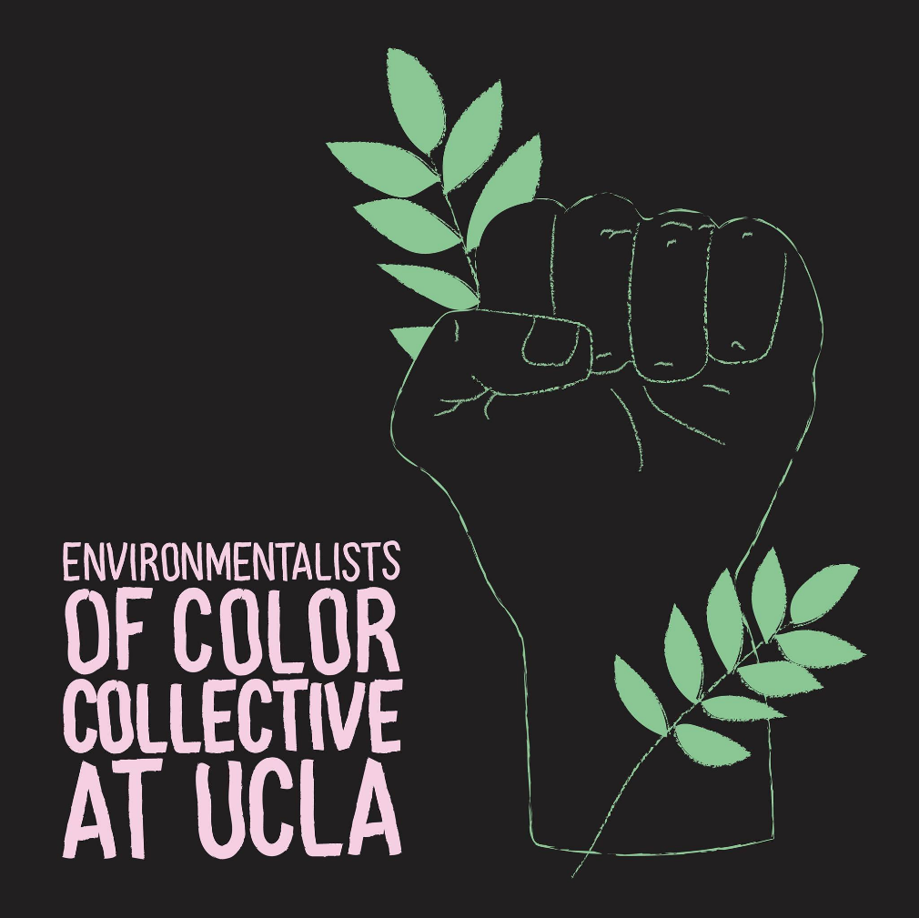
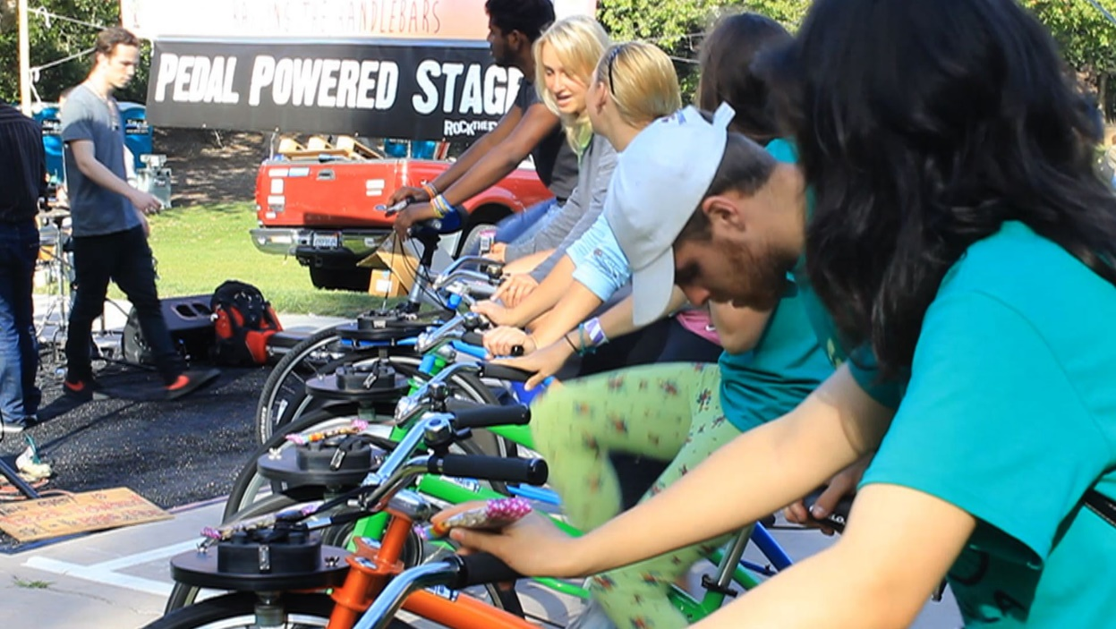
Get Involved! www.sustain.ucla.edu/get-involved
Read the Green Guide for Students
Attend an event
Join one of 25+ student groups
Volunteer w/UCLA Sustainability
Get funding for a project from TGIF
Do research with a faculty member
Take the Bending the Curve course online through UCSD
Enroll in other sustainability courses
Tell your friends & campus you care about going carbon neutral
Notes:
And – Get involved!
There are many ways to engage. Go to Sustain.ucla.edu/get-involved for lots of ideas and to learn more about the CNI and UC sustainability policies and practices…
Check out the Green Guide for UCLA Students on the website.
Attend an event – for example, CoastAlong, shown here at the bottom, is a concert put on each spring by UCLA students where the whole stage is powered by people pedaling bikes!
Join a student group – there are a lot of them, at last count there were over 25 groups related to environment and sustainability, including the Environmentalists of Color Collective, E3, Renewable Energy Association, and many more.
Volunteer with the UCLA sustainability Office
You can even get funding for a project on campus from TGIF – The Green Initiative Fund. Each of you pays $4 per quarter into this fund, and a committee of students selects projects that advance sustainability efforts on campus.
You can also get involved in research – find faculty doing interesting research and let them know you are interested. The Sustainable LA Grand Challenge has a program to connect students with researchers.
You can take a course inspired by the CNI, called Bending the Curve, that focuses on climate change solutions. It’s offered online through UCSD.
UCLA has many sustainability course offerings you can enroll in to learn more – these are listed on the website.
And finally, talk about climate neutrality, with your friends and family, and let the campus know you care.
-------
Photo: http://dailybruin.com/images/2013/05/ecochella-video-still.jpg
Bending the Curve course info for interested students: https://bendingthecurve.ucsd.edu/

Slide 36
To learn more...Follow along!
Take a
picture of
this slide!
UC Climate Solutions: @ClimateUC
UCLA Sustainability: @sustainUCLA
Join the UCLA Sustainability mailing list
For more about UCLA Sustainability, visit sustain.ucla.edu
For more about the CNI, visit universityofcalifornia.edu/initiative/carbon-neutrality-initiative
Notes:
Here are some great social media links… you can subscribe and follow along.
You can take a picture of this slide and I will also add these slides to our CCLE course website.

Slide 37
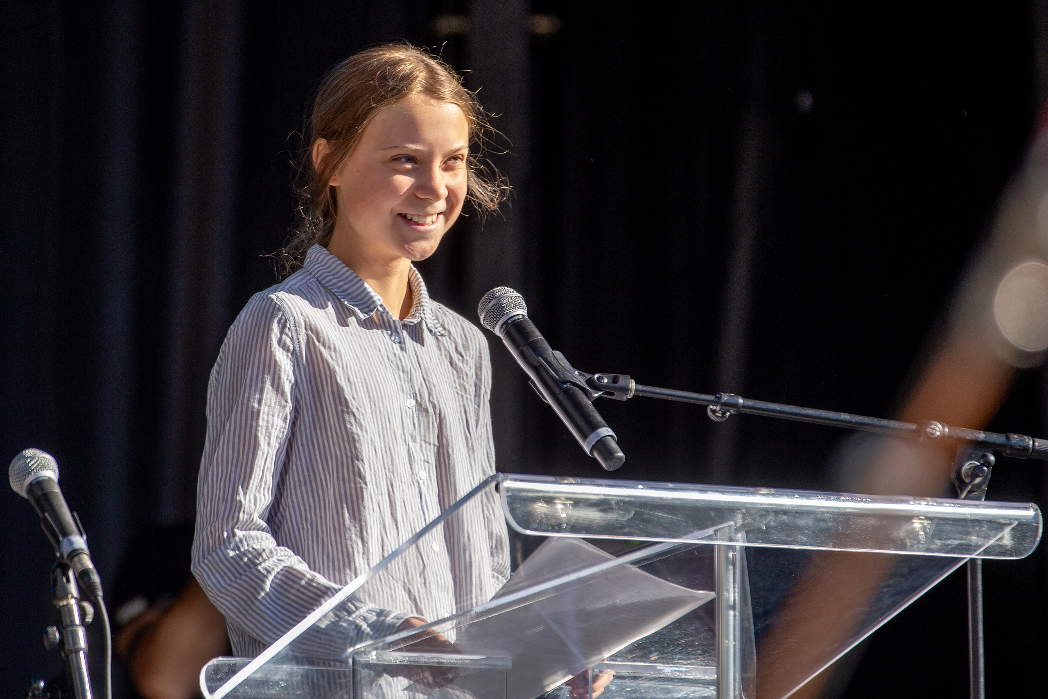
Students lead change,
what’s your superpower?
Lëa-Kim Châteauneuf
Notes:
Students lead change.
Greta Thunberg from Sweden launched her School Strike for Climate, by herself, when she was 15 years old. Her effort has inspired millions of young people around the world to mobilize and demand climate action. You have way more power than you realize. Use it.
------------------------
Photo by Lëa-Kim Châteauneuf - Own work, CC BY-SA 4.0, https://commons.wikimedia.org/w/index.php?curid=82608802
Feedback, corrections, and comments on this presentation are very welcome.
Email Cully Nordby: nordby@ucla.edu

